Slide 1
Hello Master!
Kind helper, Me Bot
What do you want?
| 201532716 곽수빈 | | 201635805 김서윤 | | 201635813 박정훈 | | 201635841 이채현 |

Slide 2
INDEX
1
Application
2
Advantage
3
Function
4
Technology
5
Role
6
Schedule

Slide 3
1
Application
Want to make
our life
more convenient
Using variety application is confused and complex

Slide 4
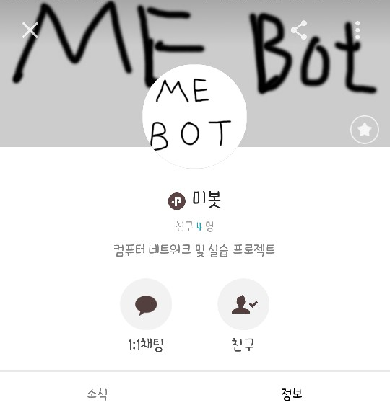

1
Application
‘미(美) 봇’
My robot
Make our life more ‘beautiful’

Slide 5




2
Advantage
Using KakaoTalk
Use only one application
Be used on any device
that can use KakaoTalk,
Familiar almost people
Do everything in one app
Available on
Multiple device
Save phone’s capacity
By reducing
the number of
applications use

Slide 6





3
Function
Picture
Search
Schedule
Management
Information
Message
Requested
information

Slide 7

4
Technology
Construct server
using L.A.M.P

Slide 8



4
Technology
Recognize picture and send suitable response.
Parsing the data
from internet.
Send suitable response to client.

Slide 9
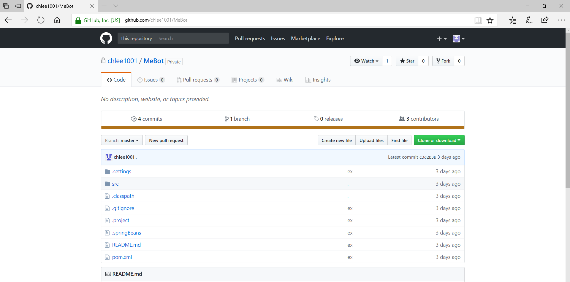
4
Technology
Using GitHub

Slide 10


5
Role
Function of ‘Providing appropriate information based on photo information’
→ 곽수빈(starfishda@naver.com)
Function of ‘Tell clients not to forget the schedule they requested’
→ 김서윤 (pkhssy@naver.com)
Function of ‘Broadcast the special day’
→ 박정훈 (pjh970820@naver.com)
Function of ‘Notice the information that client search’
→ 이채현 (chlee1001@naver.com)

Slide 11
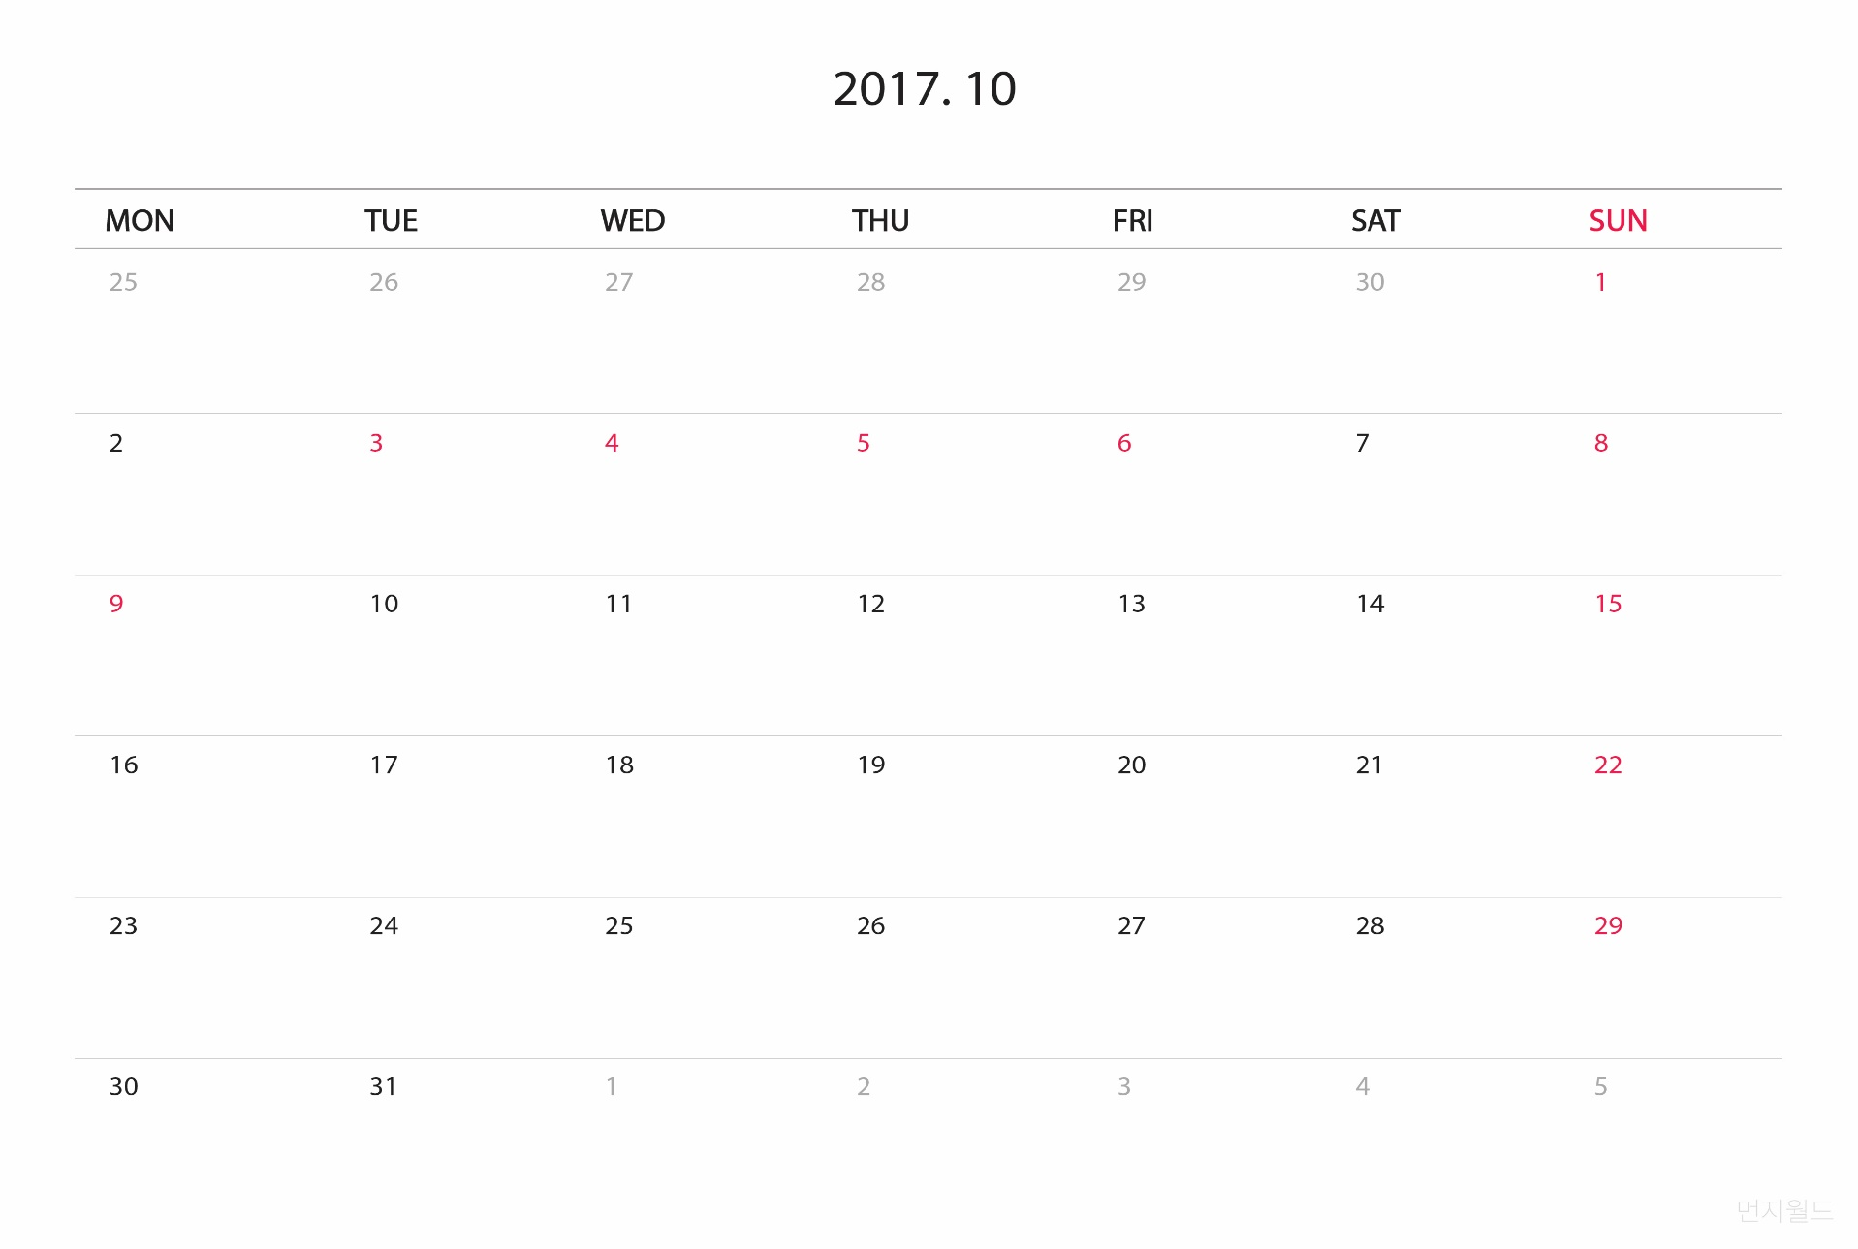
6
Schedule
* 10 / 17
= 1st proposal
* 10 / 18 ~ 30
= Proposal meeting
= Plan overall application
* 10 / 31
= 2nd proposal

Slide 12
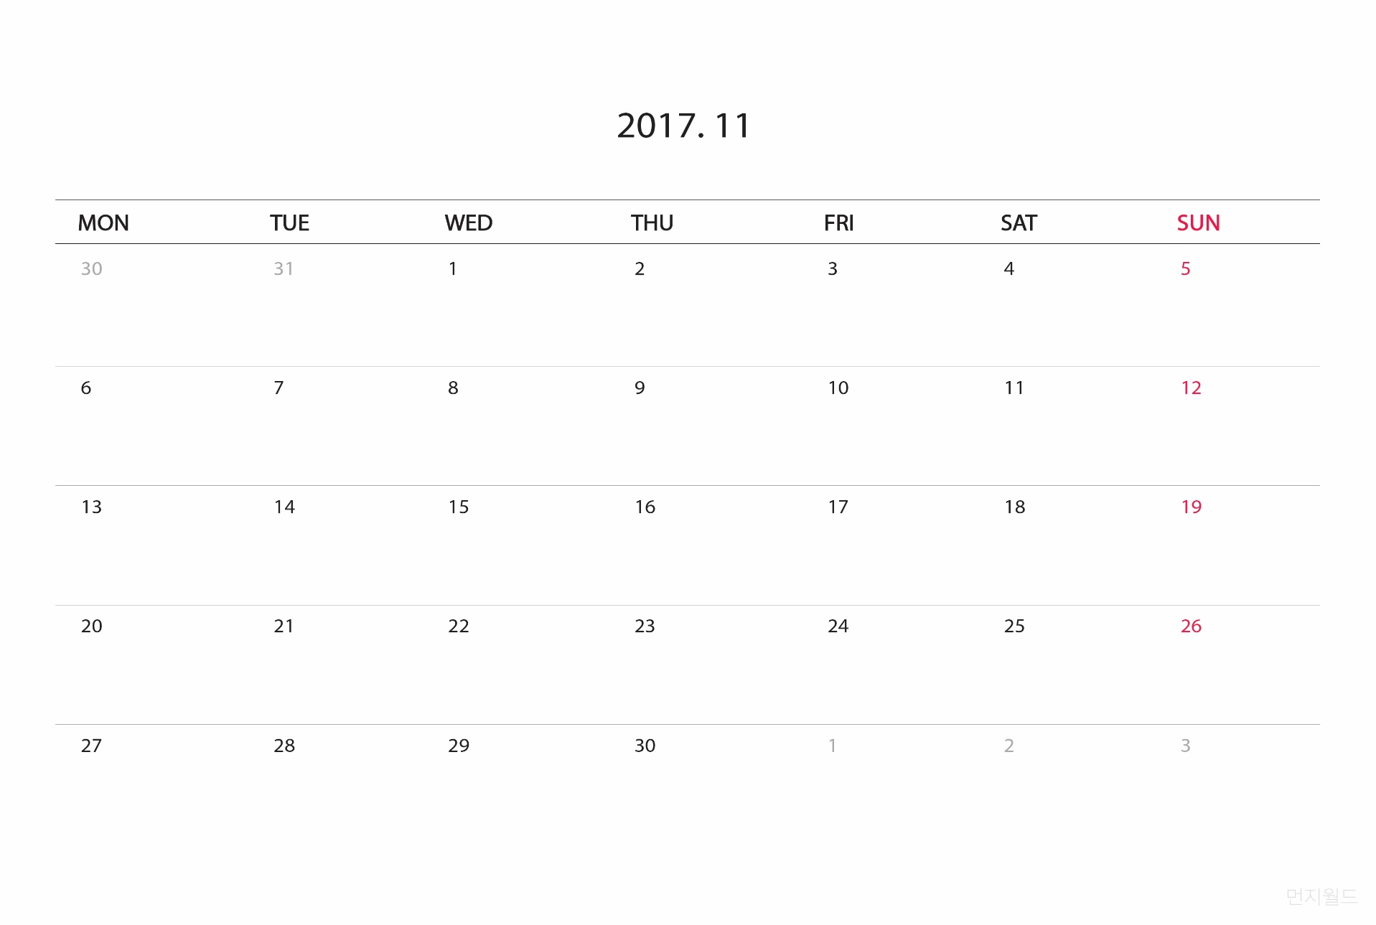
6
Schedule
* 11 / 1 ~ 12
= Realize main server
* 11 / 13 ~ 26
= Realize each function

Slide 13
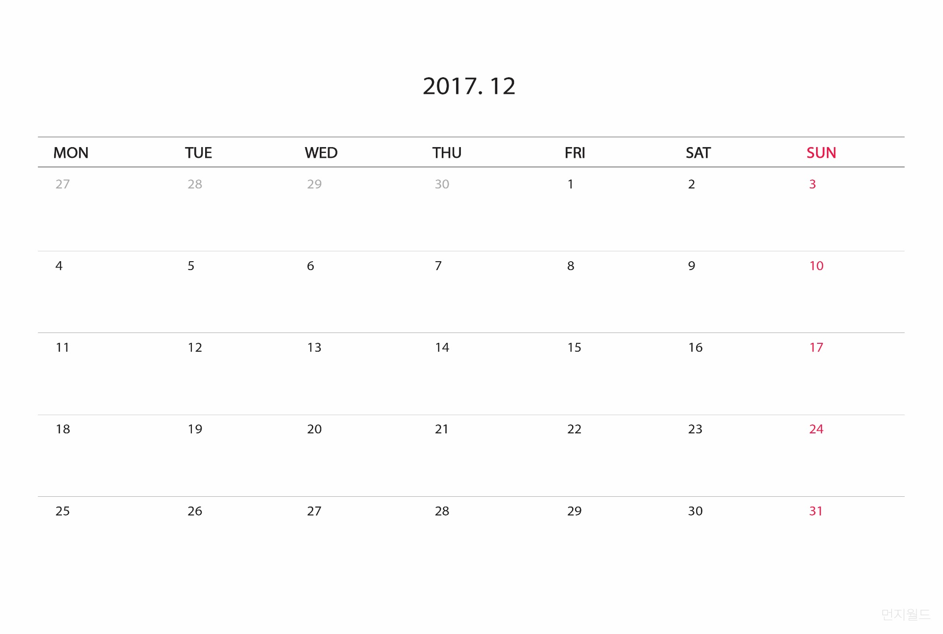
6
Schedule
* 11 / 27 ~ 12 / 3
= Final function check
* 12 / 4 ~ 11
= Prepare presentation
* 12 / 12
= Final presentation

Slide 14
THANKS!
Thanks for Listening

